Slide 1
DALLA3 KERSHAK UNIVERSITY FOOD APPLICATION
Presentation
By Team Masterpiece
Dr: Ahmed Mahran
Code: AHU20XX

Slide 2
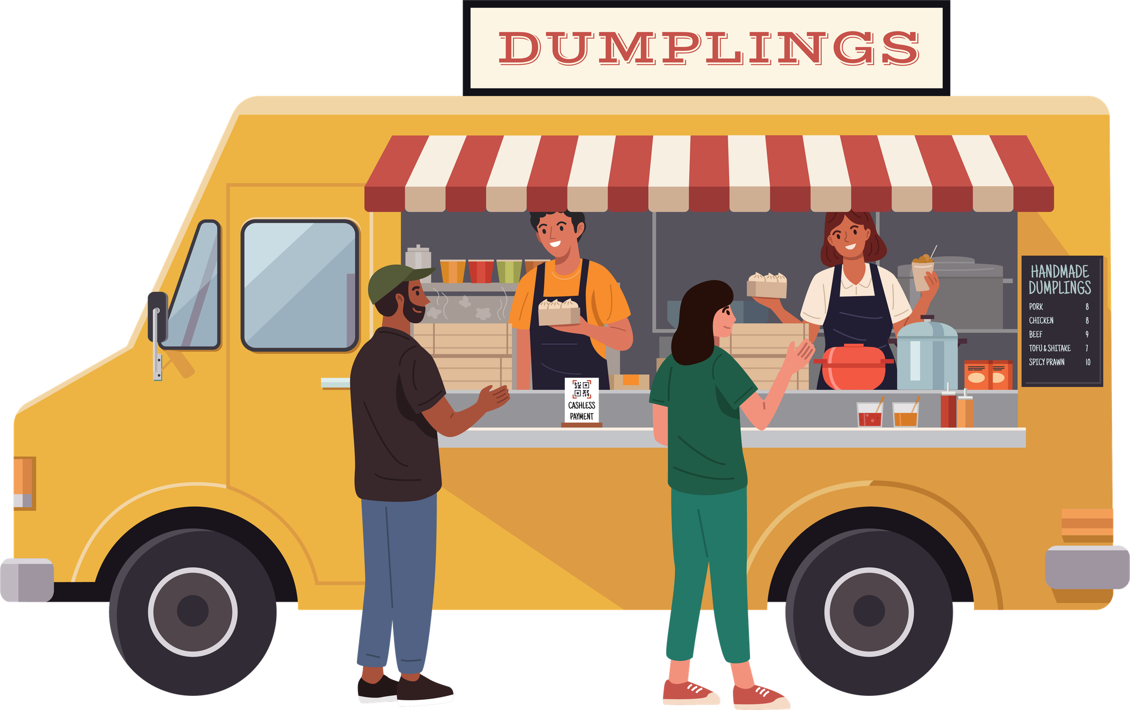
PROBLEM
  Long queues waste 20–30 mins daily
  Peak hours cap vendor capacity
  Students miss breaks & lectures
  Cash handling slows operations
  No smart campus ordering system

Slide 3
SOLUTION
"ENTER DALLA3 KERSHAK—THE DIGITAL FOOD COURT. WE ALLOW STUDENTS TO ORDER THEIR FOOD WHILE THEY ARE STILL SITTING IN THE LECTURE HALL. THEY OPEN THE APP, BROWSE THE MENUS, AND SCHEDULE AN EXACT PICKUP TIME. THEY PAY INSTANTLY THROUGH OUR CLOSED-LOOP DIGITAL WALLET. MEANWHILE, THE VENDOR RECEIVES THE ORDER ON A SIMPLE, FAST TABLET DASHBOARD. WHEN THE LECTURE ENDS, THE STUDENT WALKS DIRECTLY PAST THE MASSIVE LINE, PICKS UP THEIR HOT FOOD, AND LEAVES. WHAT USED TO TAKE 25 MINUTES NOW TAKES 30 SECONDS."

Slide 4
MARKET OPPORTUNITY
The market size here is incredibly dense. We aren't targeting a spread-out city; we are targeting thousands of students trapped in a single geographical area. At ECU alone, we have thousands of students who eat on campus almost every single day. Food is a daily, repeated habit. More importantly, this is a completely untapped niche. Once we perfect the model here at ECU, there are dozens of private universities in Egypt suffering from the exact same problem, allowing us to expand rapidly.

Slide 5
Business Model
Our business model is extremely lean and profitable because we have absolutely zero delivery logistics. We charge a flat, micro-commission of 5 EGP per completed order. It’s cheap enough that vendors won't push back, but highly lucrative at scale. In the future, we will unlock secondary revenue streams by charging vendors for promoted listings—allowing them to appear at the top of the app—and introducing subscription features for advanced vendor analytics.

Slide 6
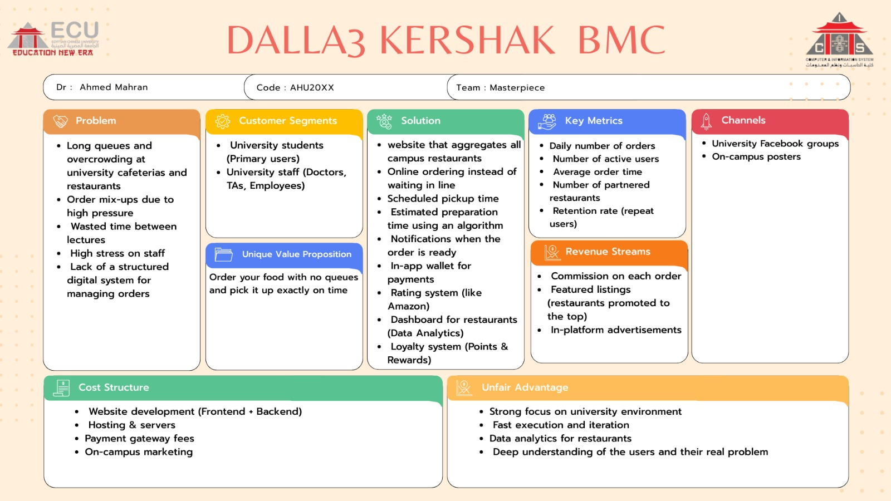
Business Model Canvas

Slide 7
GO-TO-MARKET STRATEGY
To acquire users, we don't need expensive billboards. We know exactly where our users are. We will launch exclusively inside ECU to start. We are placing giant QR codes at every cafeteria. We are recruiting popular students to act as brand ambassadors, and we are running highly targeted, relatable TikTok campaigns showing the pain of waiting in line. We will also run physical activation booths on campus: 'Deposit 50 EGP into the app today, and we'll give you 55 EGP in credit.

Slide 8
Competition &
Differentiation
  Talabat = delivery (not campus-fit)
  Pickup-only model
  Faster + cheaper experience
  No logistics complexity
  First mover in Egypt
You might be wondering: Why not just use Talabat or Elmenus? Because those apps are built for delivery, not campuses. Delivery drivers aren't allowed past university security gates, and an order takes 45 minutes. Dalla3 Kershak is hyper-localized. We are built specifically for campus behavior: pickup-only, zero delivery fees, and zero fleet logistics. We have the first-mover advantage in this highly specific niche.

Slide 9
Financials
Because we don’t pay drivers, our operational costs are very low. Based on our projections, capturing a limited number of daily orders at ECU will generate around 30,000 to 35,000 EGP in commission revenue in Year 1. As we gradually expand to two or three additional campuses in Year 2, revenue increases to around 70,000 to 80,000 EGP, and reaches approximately 90,000 to 100,000 EGP in Year 3. Since our primary costs are limited to server hosting and targeted marketing, we expect to reach break-even relatively early after launch.

Slide 10
The Ask
We are seeking an initial investment between 50,000 and 100,000 EGP. This funding will be used for system development, purchasing devices for vendors, and on-campus marketing. The goal is to launch the product and acquire the first 1,000 users."
Funding Breakdown:
  40% Development
  30% Hardware
  30% Marketing

Slide 11
Impact
Our vision is simple: we want to become the number one campus ordering system in the country. We want to save millions of collective student hours, allowing them to focus on studying and socializing rather than standing in a sweaty line. We want to digitize the entire university dining experience and build a smart campus ecosystem. Join us in making the physical queue a thing of the past. Thank you.

Slide 12
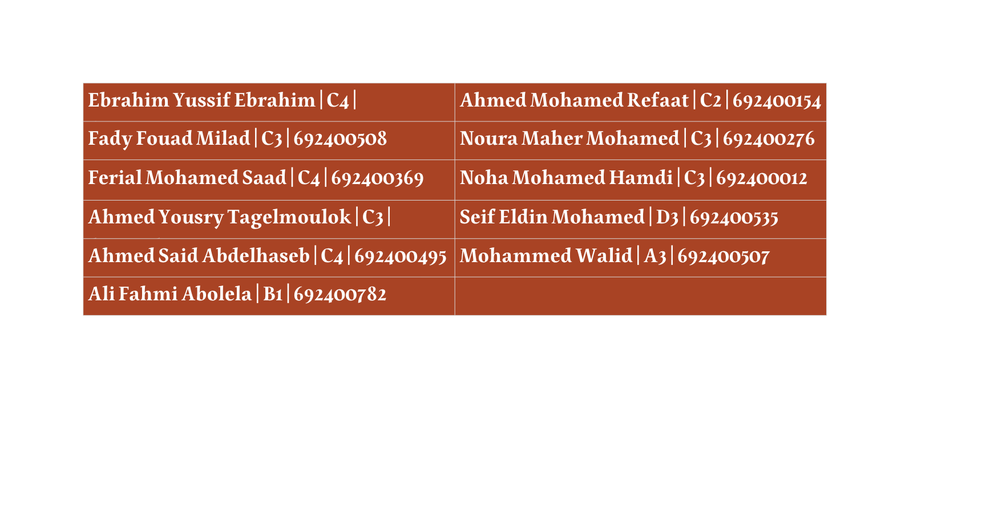
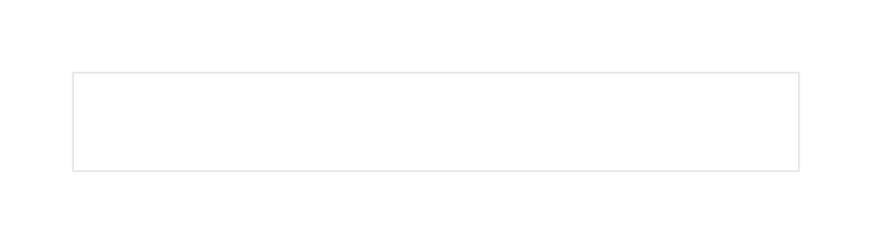
Thank You
We would like to sincerely thank Dr. Soha Safwat and Dr. Ahmed Mahran for their valuable support and great efforts throughout our project.
Your guidance and encouragement meant a lot to us and truly made a significant difference.
OUR TEAM:

Slide 13
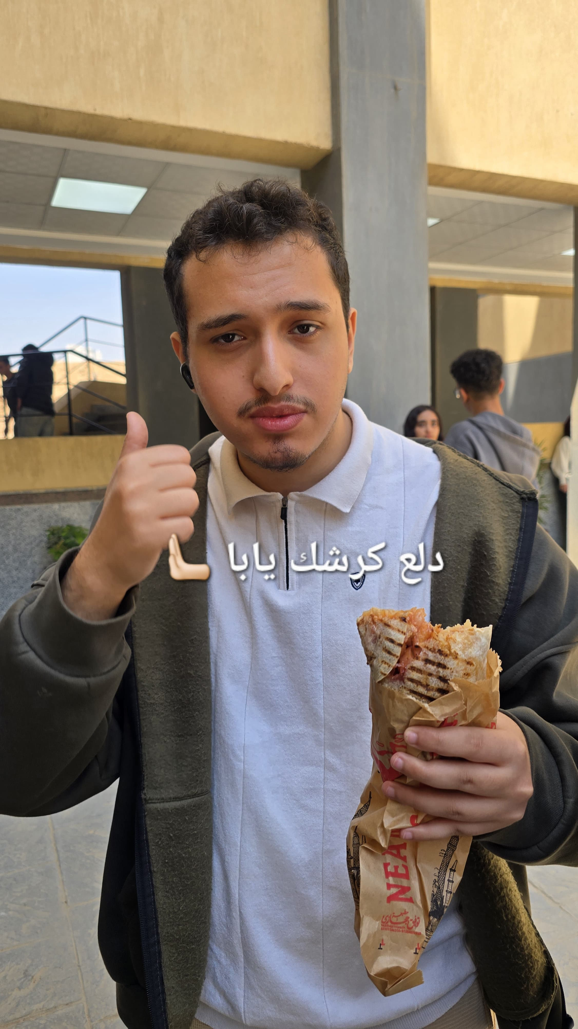
دمتم
سالمين

